Slide 1
Software system modeling
Modeling is used in science and engineering to provide abstraction of a system at some level of precision and detail. The model is then analyzed in order to obtain a better understanding of the system being developed.
System models – Abstract descriptions of systems whose requirements are being analysed
Models are built and analysed prior to implementation of the system and used to direct to subsequent implementation

Slide 2
According to the Object Modeling Group (OMG), “modeling is the designing of software applications before coding.”

Slide 3
OBJECT-ORIENTED METHODS AND THE UNIFIED MODELING LANGUAGE
Object-oriented concepts are crucial in software analysis and design because they address fundamental issues of software modifiability, adaptation, and evolution
Object-oriented methods are based on the concepts of information hiding, classes,
and inheritance.

Slide 4
Example of modeling and architecture
A model of the great
pyramid of Egypt

Slide 5
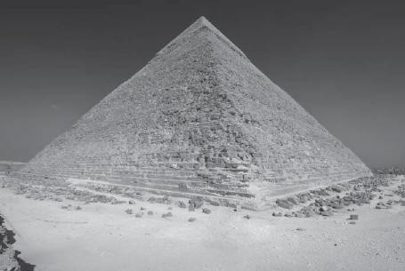
The great pyramid of Egypt

Slide 6
Unified Modeling Language (UML) was developed to provide a standardized graphical language and notation for describing object-oriented models.

Slide 7
SOFTWARE ARCHITECTURAL DESIGN
A software architecture describes the overall structure of the system, in terms of components and their interconnections
The emphasis on components and their interconnections is sometimes referred to as programming-in-the-large, and the detailed design of individual components is referred to as programming-in-the-small.

Slide 8
A software architecture can be described at different levels of detail.
At a high level, it can describe the decomposition of the software system into subsystems.
At a lower level, it can describe the decomposition of subsystems into modules or components

Slide 9
The software quality attributes of a system should be considered when developing the software architecture.
These attributes relate to how the architecture addresses important nonfunctional requirements, such as performance, security, and
maintainability
The software architecture is sometimes referred to as a high-level design.

Slide 10
A software design notation is a means of describing a software design either
graphically or textually, or both.
For example, class diagrams are a graphical design notation, and pseudocode is a textual design notation. UML is a graphical notation
for object-oriented software applications.

Slide 11
A software design concept is a fundamental idea that can be applied to designing
a system.
For example, information hiding is a software design concept.

Slide 12
A software design strategy is an overall plan and direction for developing a design.
For example, object-oriented decomposition is a software design strategy.

Slide 13
Software structuring criteria are guidelines used to help a designer in structuring a software system into its components.
For example, object structuring criteria provide guidelines for decomposing the system into objects.

Slide 14
A software design method is a systematic approach that describes the sequence of steps to follow in order to create a design, given the software requirements of the application.

Slide 15
UML DIAGRAMS (The UML notation supports the following diagrams for application development)
State
Diagrams
State
Diagrams
Class
Diagrams
Use Case
Diagrams
Use Case
Diagrams
State
Diagrams
Use Case
Diagrams
Use Case
Diagrams
State
Diagrams
Use Case
Diagrams
Object
Diagrams
Sequence
Diagrams
Scenario
Diagrams
State
Diagrams
Scenario
Diagrams
State
Diagrams
Collaboration
Diagrams
Component
Diagrams
Models
Scenario
Diagrams
Component
Diagrams
Scenario
Diagrams
Component
Diagrams
Statechart
Diagrams
Deployment
Diagrams
Activity
Diagrams

